Slide 1

ML-Ready Dataset Preparation for Environmental Impacts Prediction
CMPT 2400 - Data Preparations and Analytics
Data Project 1
Exploratory Data Analysis and Data Cleaning
of NPRI Dataset
Alma Soria | Angela Lekivetz | Crystal Blackburn | Michaela Goud

Slide 2

Introduction to NPRI Dataset
NPRI Dataset: Provides data on pollutant releases, disposals, and transfers in Canada.
Focus: Analysis of pollutant releases, particularly in the "Releases 2000-2020" sheet.
Goal: Develop predictive models to forecast future pollutant release trends.

Slide 3
Data Source and Structure
Releases 2000-2020:
Records: 737,516
Columns: 28
Focus: Pollutant releases to air, land, and water.
Disposals and Transfers 00-20:
Records: 191,645
Columns: 41
Comments:
Records: 363,310
Columns: 14
Important Columns:
Reporting_Year: Year of the release incident.
NPRI_ID: Unique identifier for the reporting facility.
Company_Name: Name of the reporting company.
Facility_Name: Name of the facility.
NAICS: North American Industry Classification System code.
NAICS_Title: Description of the NAICS code.
Substance_Name: Name of the released substance.
Units: Measurement units for release quantities.
Various Release Quantities: Release quantities across air, water, and land.

Slide 4

Data Cleaning and Preparation
Fixing Bad Housekeeping
Convert Column Names to a Consistent Format: We remove French labels and unnecessary spaces from column names to achieve a standardized format.
Textual Data: Columns such as Company_Name, Facility_Name, NAICS, Substance_Name, CAS_Number, Province, City, and Estimation_Method are converted to the category data type for memory optimization.
Numeric Data: Columns like Reporting_Year, NPRI_ID, Latitude, and Longitude are retained in their original formats. The Number of employees column is converted to a numeric type after handling non-numeric characters.
Text and Typo Inconsistencies: Categorical values like CAS_Number and Substance_Name contained errors

Slide 5

Issue Detection
Duplicate Records: No duplicates were found.
Text and Typo Inconsistencies: Categorical values like CAS_Number and Substance_Name contained errors
Accents Removal: The remove_accents function was used to ensure that accented characters were converted to their non-accented equivalents.
Replacing Punctuation: Rather than removing punctuation entirely, we replace them with a space

Slide 6
Issue Detection continued…
Cleaning Text in Columns: Cas_Number, Substance_Name, Company_Name, Facility_Name, NAICS_Title, Province, City
Whitespace & Substring Removal: Remove extra spaces and substrings like "0:00".
Standardizing NA Values: Convert "NA - 09" to "NA-09".
Validation: Use regex to check if the CAS number follows the correct format.
Preview Data: Print each substance in the column to analyze its format and identify cleaning and standardization methods.
Create functions for cleaning and standardizing the column by applying several transformations

Slide 7
Handling Missing Values
The NPRI dataset contains specific patterns of missing values that require a targeted approach informed by domain knowledge, specifically with “Releases” columns where unreported releases often indicate no release occurred.
Missing values can introduce bias if handled incorrectly, it’s crucial to select the appropriate imputation strategy.
Number of Employees: Groupby NAICS and Median imputation.
Facility Name: fill with “Company_Name” + “Unknown”
City: filled using reverse georecording (!pip install reverse_geocoder) when latitude and longitude available, if not use Capital of Province.
Latitude/Longitude: fill with grouped data by City and fill with Median.
Release columns: Zero imputation
Sum of release to all media <1 tonne: Calculated from other releases

Slide 8
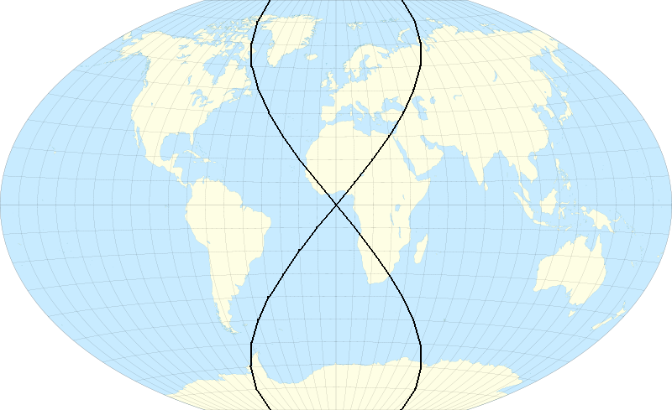
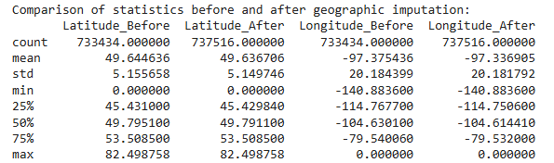
Descriptive Statistics
The descriptive statistics for the Latitude and Longitude columns were calculated using the .describe() method.
This serves as a baseline to assess the data's distribution before performing any imputation.
Statistical summary of Latitude and Longitude columns.
Comparison before and after imputation.

Slide 9
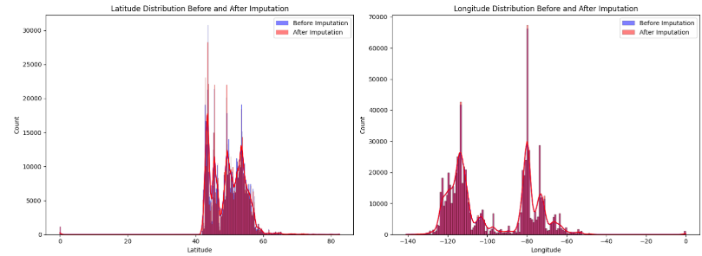
Missing Values Imputation Comparison Overview - Latitude & Longitude
Similar Distributions: The histograms for latitude and longitude before and after imputation are largely similar, indicating minimal impact.
Minimal Changes: Small shifts in mean or median values, but imputed data follows original trends.
Consistent Spread: The range and standard deviation remain stable, with no significant changes.
Pattern Preservation: Key geographic features are preserved after imputation, indicating effective strategy.

Slide 10
Missing Values Imputation Comparison Overview - City
Consistency in Top Cities: The top cities before and after imputation remained largely consistent
Slight Changes in Rankings or Counts: There were minor shifts in the rankings and counts of some cities, which can be attributed to the handling of previously missing values, now correctly imputed.
Impact of Imputation on Data Completeness: The imputation led to an increase in the total counts for certain cities, indicating that missing city information had been successfully filled.

Slide 11
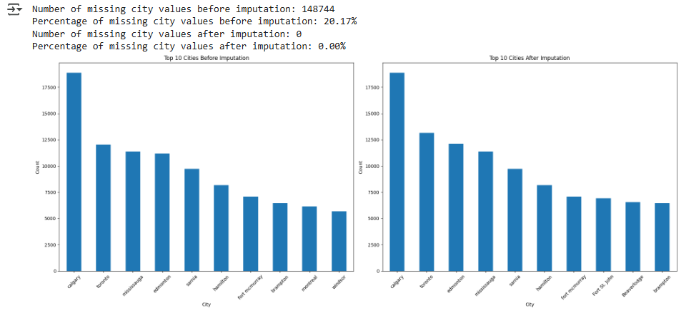
Missing Values Imputation Comparison Overview - City

Slide 12
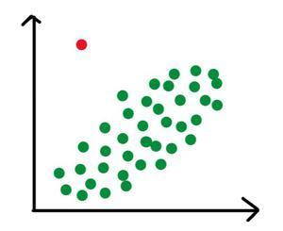
Handling Outliers
Purpose of Identifying Outliers: Outliers in the release columns are important to identify as they could indicate data errors, exceptional events, or significant changes in emissions.
Statistical Techniques Applied: Various statistical methods were used to detect outliers in the release columns.
Importance in Environmental Data: The release columns are key in environmental data analysis, so handling outliers helps ensure data accuracy.
Impact on Models and Analyses: Managing outliers is crucial for refining models and improving the quality of analysis.

Slide 13
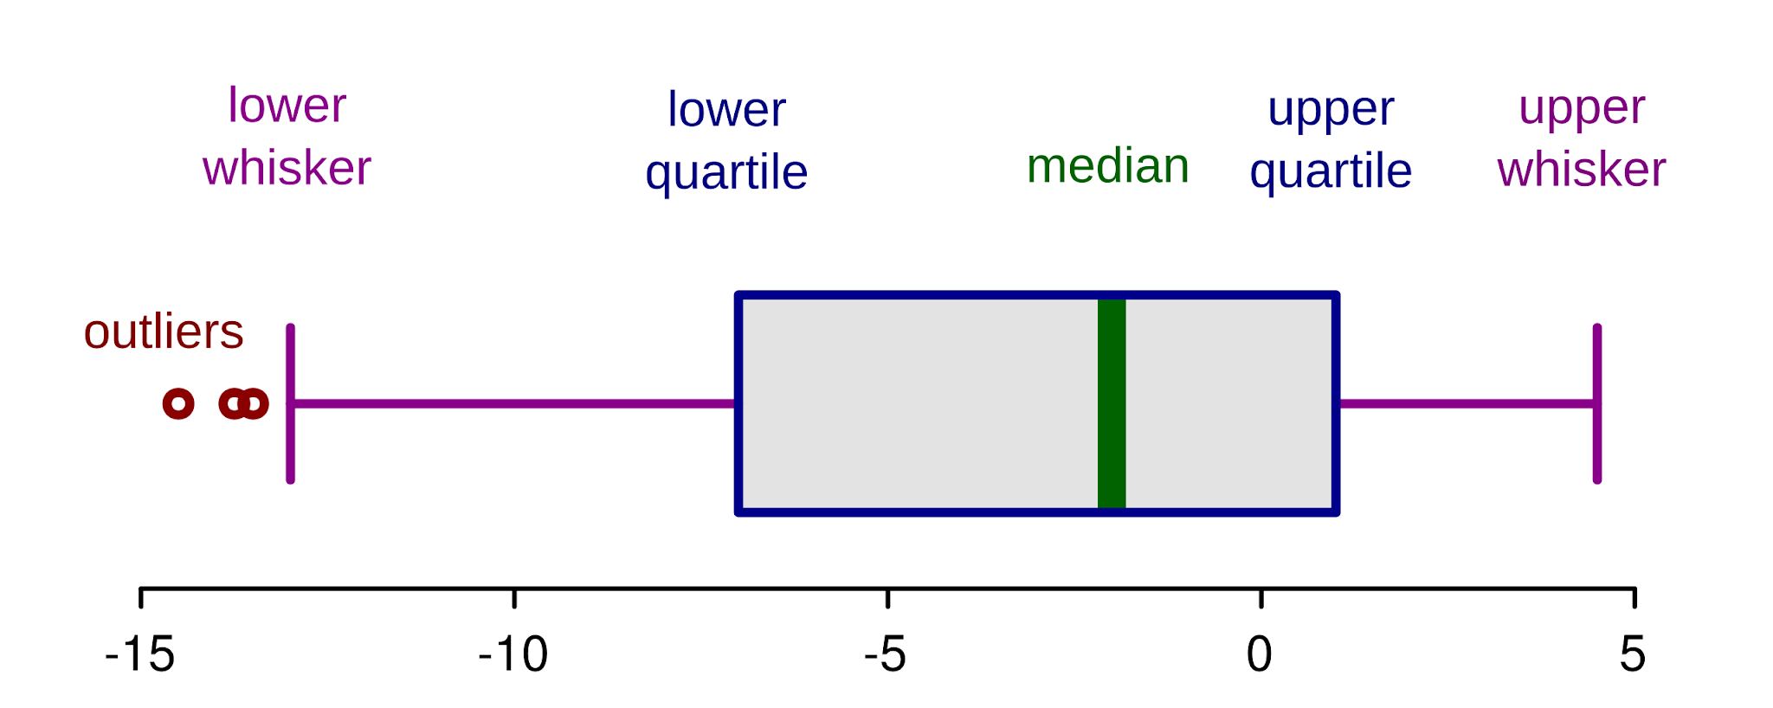
Handling Outliers
Outlier Detection Methods Compared:
We compared three methods for detecting outliers:
IQR with all values
IQR excluding zeros
Z-score
Chosen Method for Handling Outliers: Capping was selected as the method to handle outliers.
Capping Explained: Capping replaces extreme values with the upper or lower bounds defined by the IQR or Z-score methods.
Benefits of Capping: This method reduces the influence of outliers without removing data points, preserving dataset integrity while mitigating outlier impact.

Slide 14
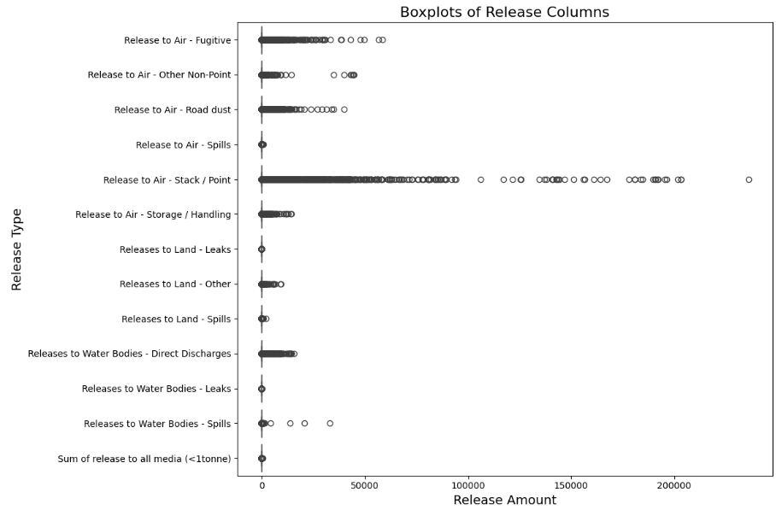
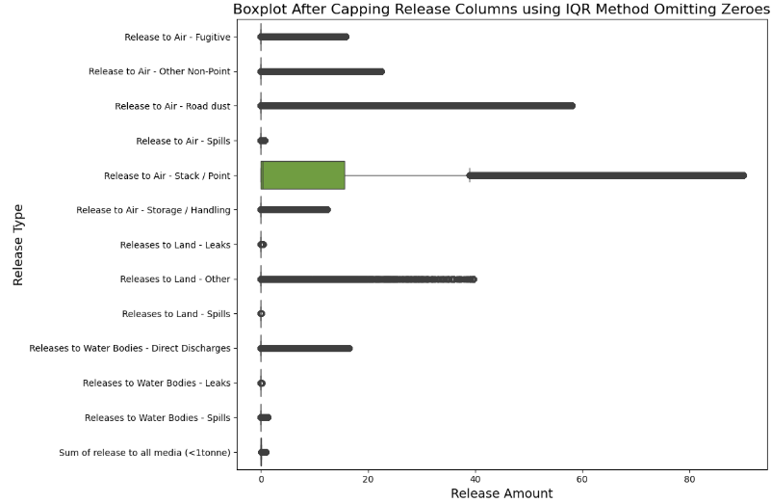
Visualization of Capped Outliers
Boxplots showing the impact of capping on release columns.

Slide 15
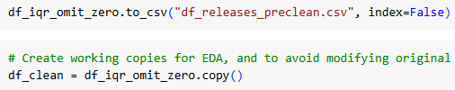
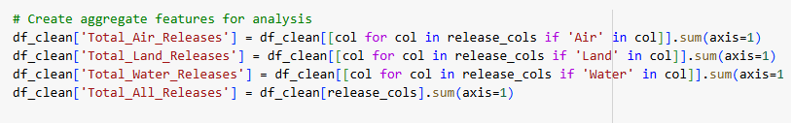
Pattern Discovery, Visualization & Statistics
Pre-cleaned dataset saved for reference.
Creation of aggregated features.

Slide 16
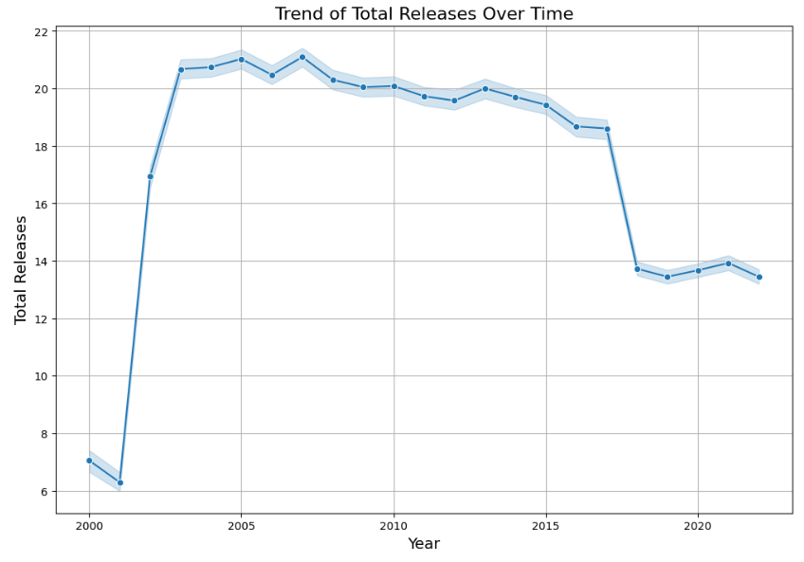
Pattern Discovery, Visualization & Statistics
Pollutant Releases Trend: A line plot shows pollutant releases over time.
Key Findings:
Significant increase in releases between 2000 and 2003.
Plateau in releases from 2003 to 2017.
Sharp decline in releases in 2017.
Possible Causes: The trend may indicate changes in industrial practices, reporting requirements, or regulatory changes.

Slide 17
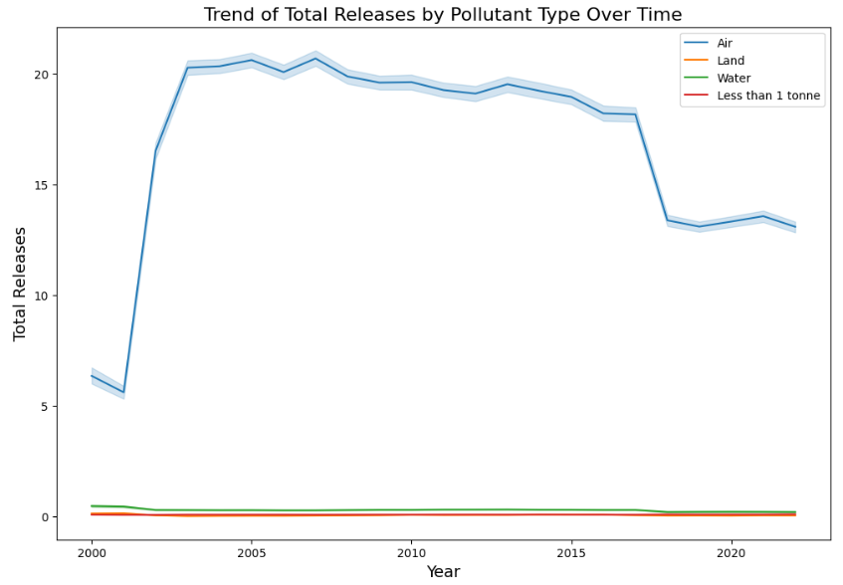
Pattern Discovery, Visualization & Statistics
Dominant Release Type: Air releases consistently dominate the total releases over time.
Overall Trend: "Air" pollutants drive the overall trend in pollutant releases.
Other Release Types: Releases to land, water, and those below 1 tonne remain stable and low.

Slide 18
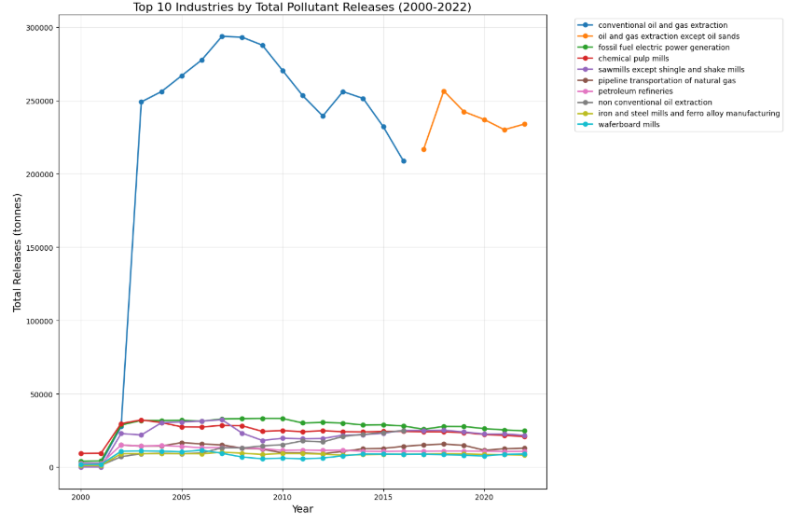
Pattern Discovery, Visualization & Statistics
Industry Analysis: The top 10 industries with the highest pollutant releases were analyzed for historical trends.
Key Industry Highlighted: "Conventional oil and gas extraction" stands out for its disproportionately high pollutant releases.
Importance: Understanding these trends is crucial for investigating regulatory and operational influences.

Slide 19
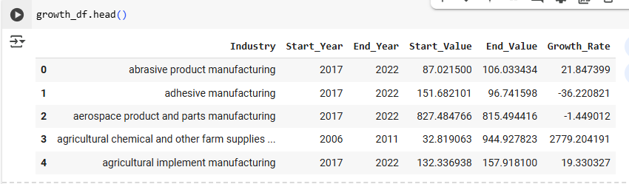
Growth Rate
Growth Rate Calculation: Year-over-year growth rate is calculated to measure the growth or decline of releases in different industries.
Purpose: This analysis helps predict future trends in industrial pollution.
Application: The insights support the development of a predictive model for industrial pollution.

Slide 20
Other Insights
Correlation Analysis:
Weak relationships were found between different release types (e.g., air, land, and water releases).
This suggests that each pollutant type may be influenced by distinct industrial processes.
Insights can aid in feature selection for predictive models.
Geographical Distribution of Pollutants:
Importance: Location is crucial for understanding pollution patterns.
Sources of pollutants are often linked to regional industrial activities, regulations, and economic conditions.

Slide 21
Other Insights
Alberta: Highest pollutant releases, driven by oil, gas, and industrial sectors with less stringent regulations.
Ontario: Second in releases, primarily from manufacturing, transportation, and industrial hubs.
British Columbia: Third, with emissions from resource extraction, processing, transportation, and agriculture.
Quebec and Saskatchewan: Moderate emissions from diverse industries like mining and forestry.
Other Provinces/Territories: Lower releases, due to smaller industries and stricter environmental policies.

Slide 22
Time Series Decomposition
Time Series Decomposition Importance:
Breaks data into trend, seasonal, and residual components.
Helps identify trends, cyclical patterns, and assess prediction confidence.
Observations:
Conventional Oil and Gas Extraction: Upward trend until 2008, then decline, with variability suggesting additional factors beyond seasonality.
Fossil Fuel Electric Power Generation: Growth until 2010, then decline, with seasonal fluctuations linked to energy demand and high volatility due to unpredictable factors.

Slide 23
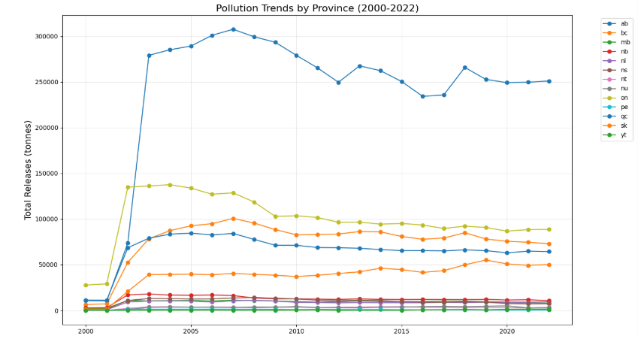
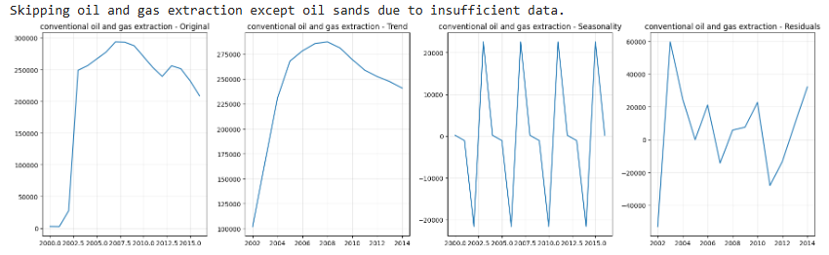
Conclusion
Key Findings: Significant regional variations in pollutant releases across Canada.
Analysis Techniques: Geographical distribution of emissions, time series decomposition, and industry trend visualization.
Next Step: Building predictive models to forecast future pollutant releases and identify industries with the most significant changes.

Slide 24
Thankyou!
Links to the notebook, datasets, reports and resources:
NPRI_2000-2022.xlsx (Excel dataset)
df_releases.csv
Data_Project_1_2400.html
final notebook link

